Slide 1
http://www.vidyanidhi.com/
ketkiacharya.net@gmail.com
Ketki Acharya
From: SM VITA ATC of CDAC
9769201036
ketkiacharya.net@gmail.com

Slide 2
Json
Javascript Script Object Notation

Slide 3
JSON
JSON: JavaScript Object Notation.
JSON is a syntax for storing and exchanging data.
JSON is text, written with JavaScript object notation
JSON is a lightweight data-interchange format
JSON is "self-describing" and easy to understand
JSON is language independent *

Slide 4
Why JSON
It is a lightweight data-interchange format.
It is easy for humans to read and write.
It is easy for machines to parse and generate.
It is based on a subset of the JavaScript Programming Language, Standard ECMA-262 3rd Edition - December 1999.
JSON is a text format that is completely language independent but uses conventions that are familiar to programmers of the C-family of languages, including C, C++, C#, Java, JavaScript, Perl, Python, and many others.
These properties make JSON an ideal data-interchange language.

Slide 5
JSON is built on two structures:
A collection of name/value pairs.
In various languages, this is realized as an object, record, struct, dictionary, hash table, keyed list, or associative array.
An ordered list of values.
In most languages, this is realized as an array, vector, list, or sequence
These are universal data structures.
Virtually all modern programming languages support them in one form or another.
It makes sense that a data format that is interchangeable with programming languages also be based on these structures.

Slide 6
Much Like XML
JSON is plain text
JSON is "self-describing" (human readable)
JSON is hierarchical (values within values)
JSON can be parsed by JavaScript
JSON data can be transported using AJAX
Much Unlike XML
No end tag
Shorter
Quicker to read and write
Can be parsed using built-in JavaScript eval()
Uses arrays
No reserved words

Slide 7
Why JSON?
For AJAX applications, JSON is faster and easier than XML:
Using XML
Fetch an XML document
Use the XML DOM to loop through the document
Extract values and store in variables
Using JSON
Fetch a JSON string
eval() the JSON string

Slide 8
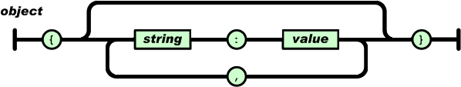
In JSON, they take on these forms:
An object is an unordered set of name/value pairs.
An object begins with { (left brace) and ends with } (right brace).
Each name is followed by : (colon) and the name/value pairs are separated by , (comma).

Slide 9
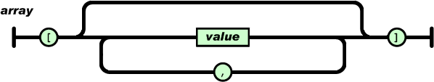
An array is an ordered collection of values. An array begins with [ (left bracket) and ends with ] (right bracket). Values are separated by , (comma).

Slide 10
<!DOCTYPE html>
<html><body>
<h2>Store and retrieve data from local storage.</h2>
<p id="demo"></p>
<button onclick="go()" >set Json String</button>
<button onclick="getdata()">Get Object</button>
<script>
var myObj, myJSON, text, obj;
function go()
{
// Storing data:
myObj = { name: "John", age: 31, city: "New York" };
myJSON = JSON.stringify(myObj);
localStorage.setItem("testJSON", myJSON);
}
function getdata()
{// Retrieving data:
text = localStorage.getItem("testJSON");
obj = JSON.parse(text);
document.getElementById("demo").innerHTML = obj.name + " "+obj.age;
}
</script></body></html>
When storing data, the data has to be a certain format, and regardless of where you choose to store it, text is always one of the legal formats.
JSON makes it possible to store JavaScript objects as text.

Slide 11
JSON Values
In JSON, values must be one of the following data types:
a string
a number
an object (JSON object)
an array
a boolean
null
In JavaScript values can be all of the above, plus any other valid JavaScript expression, including:
a function
a date
undefined

Slide 12
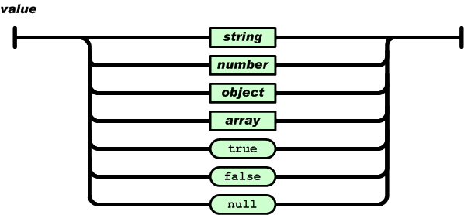
In JSON, values must be one of the following data types: In JSON, keys must be strings, written with double quotes
{ "name":“Vita" }
{ “age":30 }
{"employee": { "name":“Vita", "age":30, "city": “Mumbai" } }
{ "employees":[ “Raj", “Mona", “Geeta" ] }
{ "sale":true }
{ "middlename":null }
a string
a number
an object (JSON object)
an array
A Boolean
null

Slide 13
<!DOCTYPE html>
<html><body><p>How to access nested JSON objects.</p><p id="demo"></p>
<button onclick="readdata()">read data</button>
<script>
var myobj = { "name":"John",
"age":30,
"cars": { "car1":"Ford",
"car2":"BMW",
"car3":"Fiat"
}
}
function readdata()
{
//document.getElementById("demo").innerHTML += myObj.cars.car2 + "<br>";
//or:
//document.getElementById("demo").innerHTML += myObj.cars["car2"];
for(let x in myobj)
{ console.log(typeof(myobj[x]))
if(typeof(myobj[x]) != "object")
document.getElementById("demo").innerHTML += myobj[x];
else
{ for(let subx in myobj[x])
document.getElementById("demo").innerHTML += myobj[x][subx];}
}
}
</script></body></html>

Slide 14
<!DOCTYPE html> <html> <body>
<p>How to access nested Array.</p>
<p id="demo"></p> <button onclick="readdata()">read data</button>
<script>
var myobj = [
[ "Power Steering",
"Front and rear power windows",
"Anti-lock braking system"
],
[ "Power Windows",
"Automatic Climate Controll"
],
[ "Alloy Wheels",
"Driver Airbag"
],
[ null
],
[ null
]
]
function readdata()
{
for(let x of myobj)
{
for(let subx of x)
document.getElementById("demo").innerHTML += subx +"<br/>";
}
}
</script> </body> </html>

